Slide 1


TickeTBot - Flights Tickets Search With Telegram
Naya College
Big Data Engineer course
Final Project Presentation
Michael Naor
Yuval Mutseri
April 2022

Slide 2
Agenda
Main Goal
Architecture
Real time Pipeline
Scheduled Price Check Pipeline
Daily Parquet Archive
Airflow Dags

Slide 3



Goal
Our main goal is to make ticket search accessible in a simple and efficient way and enable regular updates on flight prices.
By connecting to the AMADEUS API we enable flight search by destination or budget. We continue to look for a better price constantly and update the customer Via Telegram Bot.
Notes:
goals

Slide 4

Leading provider of flights, hotels and insurance booking services
Stable and various API
Access to test environment
In-depth content and value-added features

Slide 5
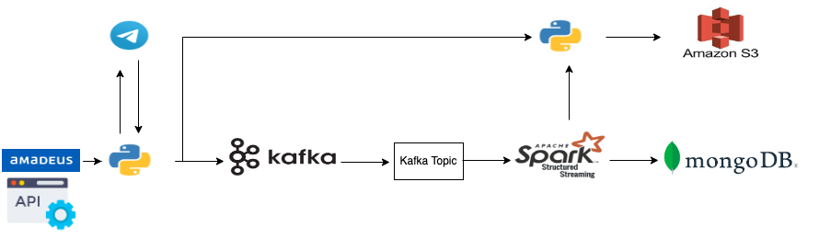
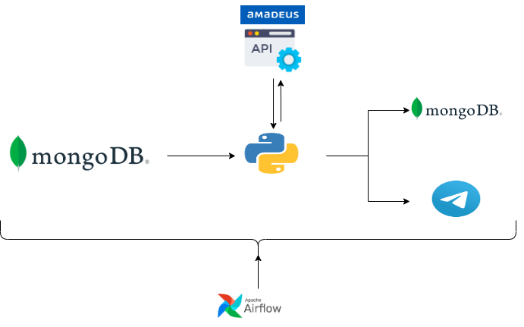
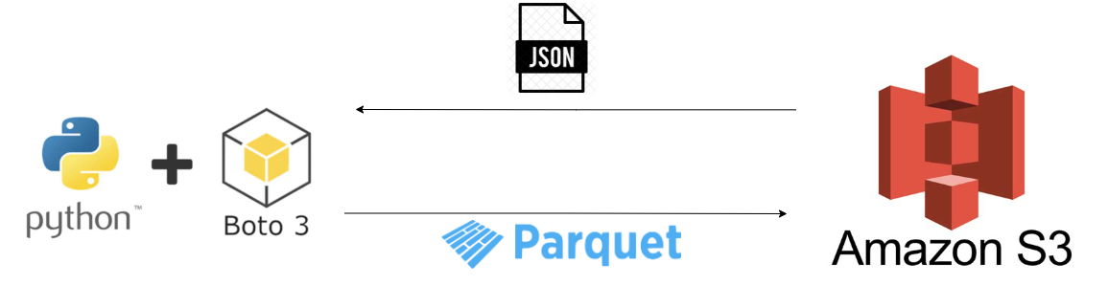

Realtime Pipeline
Scheduled Price Check Pipeline
Daily Parquet Archive

Slide 6
Realtime Pipeline

Slide 7
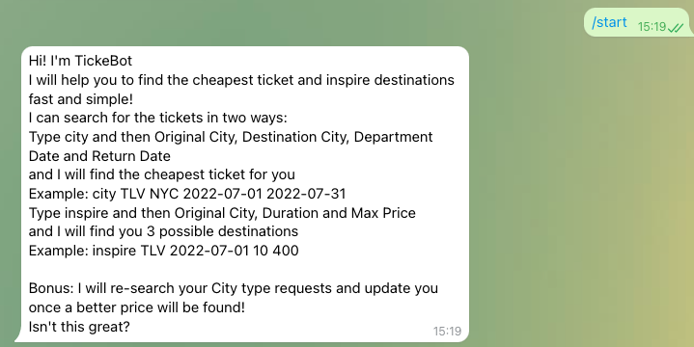

Telegram Bot
Start command with 2 ways to search the tickets: by destination and by max price

Slide 8
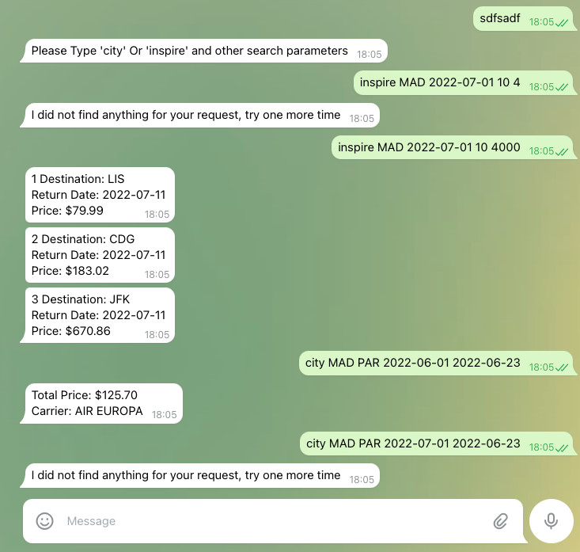
Telegram Bot
2 Types Of Error Handling
Real time response

Slide 9
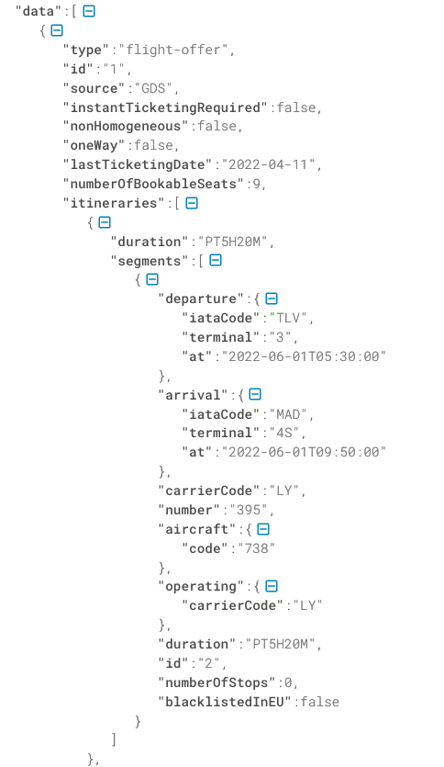
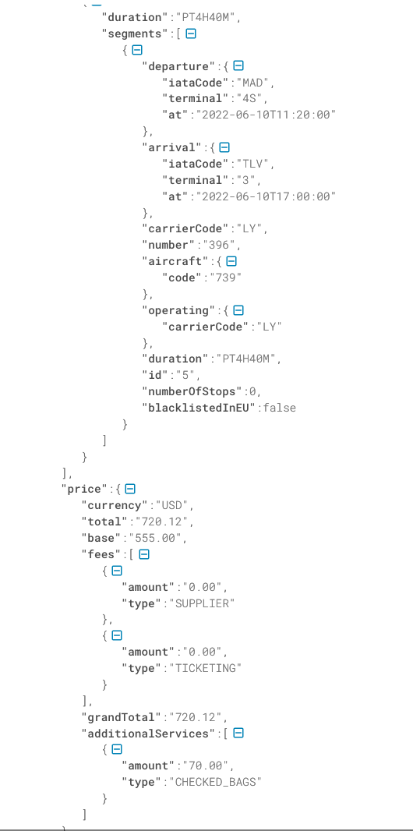
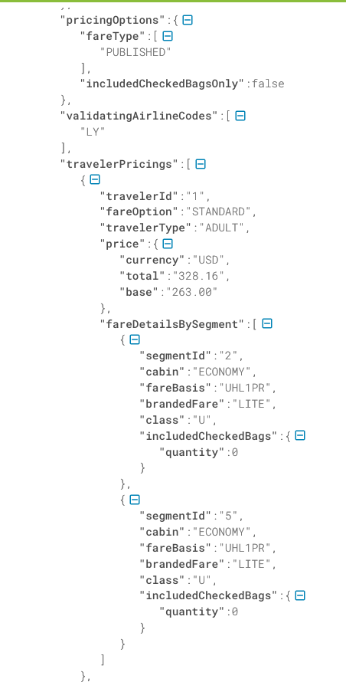
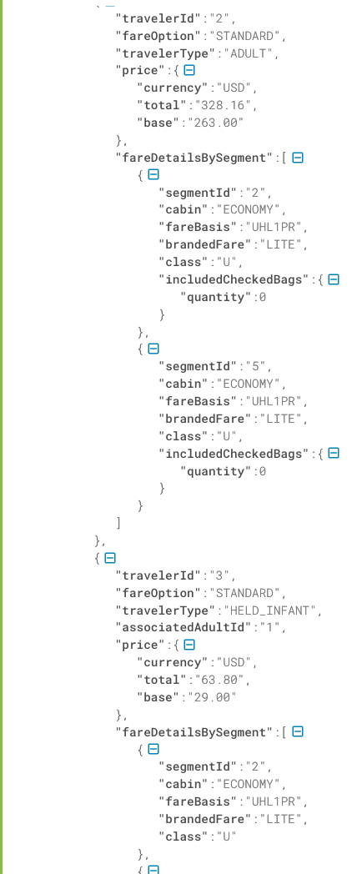

Slide 10
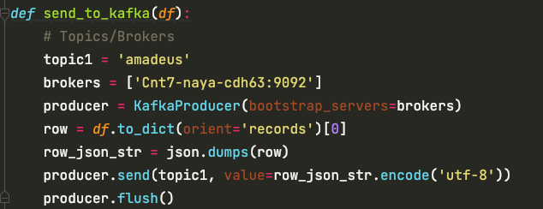

Sending Data to Kafka
Real time pipeline

Slide 11
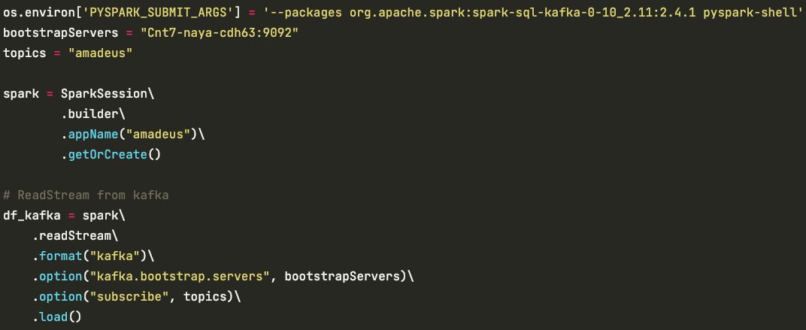

Using PySpark
Integration between Kafka and Spark using PySpark

Slide 12
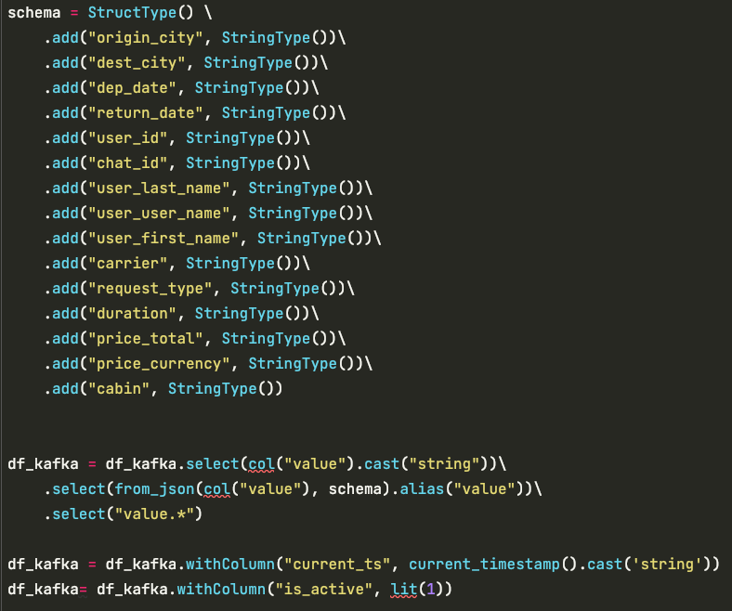
Using PySpark
Define required schema
Generate calculated columns

Slide 13
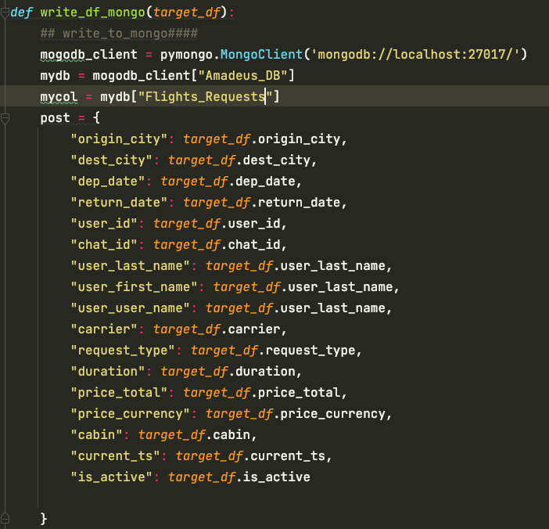

Sending DF to MongoDB
Connecting to MongoDB using PyMongo

Slide 14
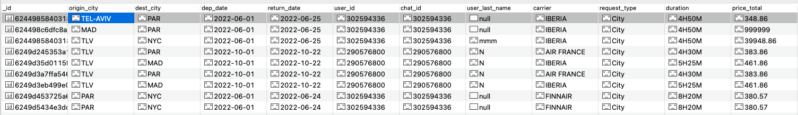
Sending DF to MongoDB

Slide 15
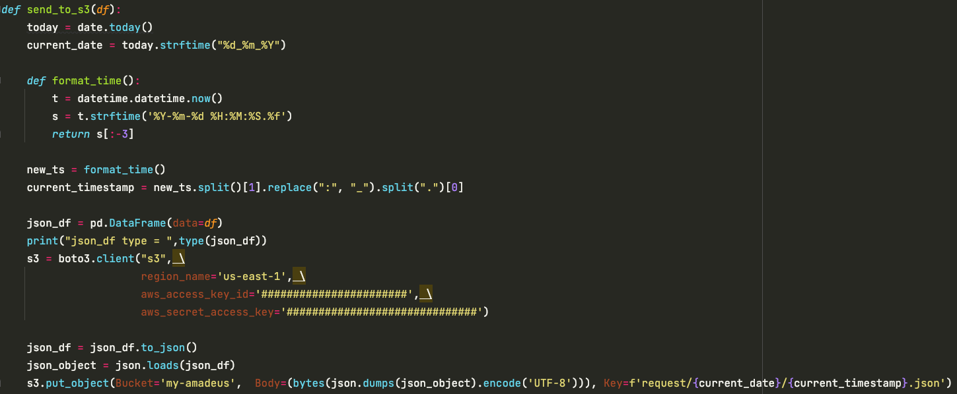

Saving Requests To Archive - S3
Dynamically generating daily partitioned buckets directories and file names.

Slide 16
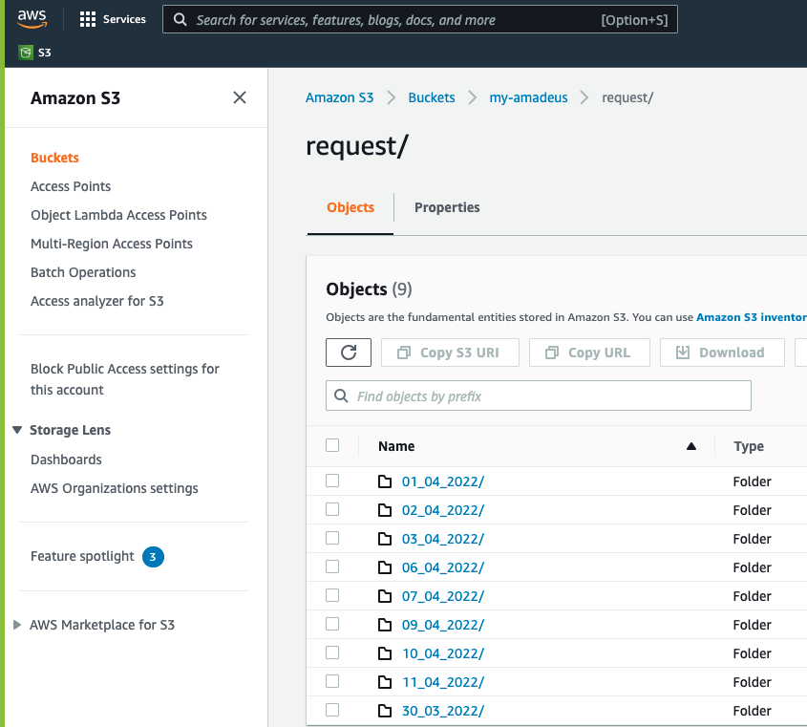
Saving Requests To Archive - S3
Partitioned buckets directories

Slide 17
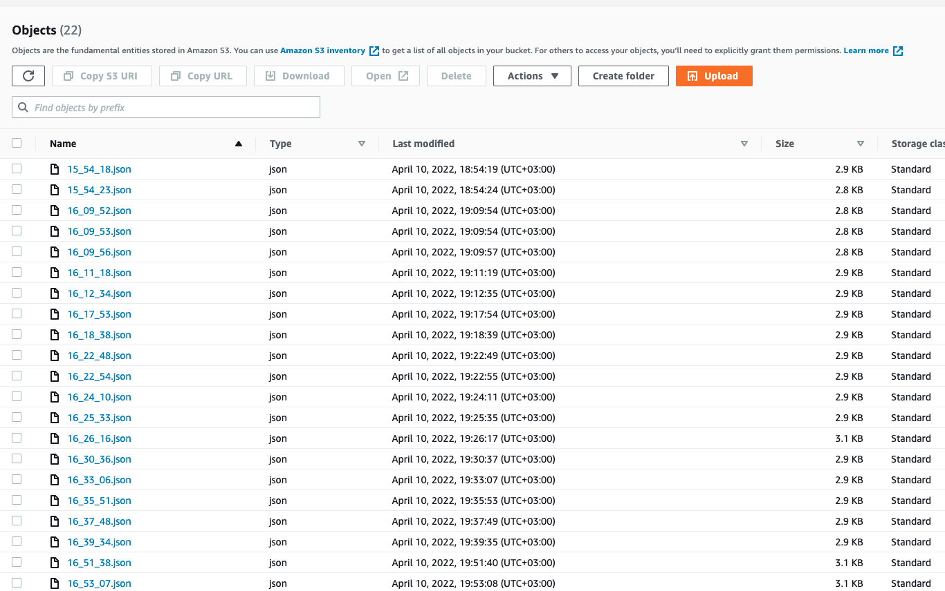
Saving Requests To Archive - S3
File names are unique with current timestamp

Slide 18
Scheduled Price Check Pipeline

Slide 19
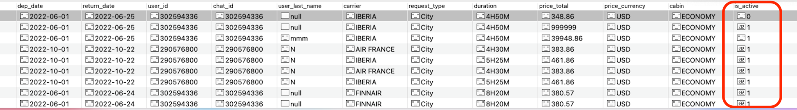
Pymongo-Pulling_Active Requests
Every request is active by default

Slide 20
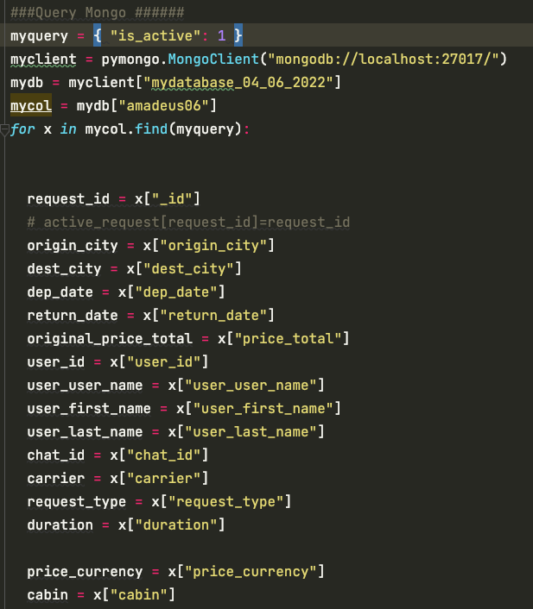
Pymongo-Pulling_Active Requests
Querying only active requests for price check

Slide 21

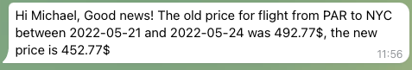
Updating the user via TickeTBot
Every user gets his own price update

Slide 22
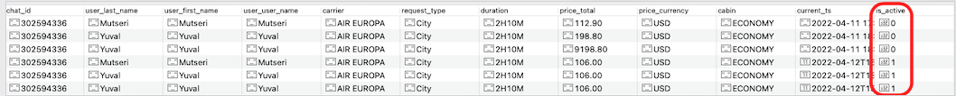
Updating MongoDB
The request with old price is marked as inactive
New row added with the current price

Slide 23
Daily Parquet Archive

Slide 24
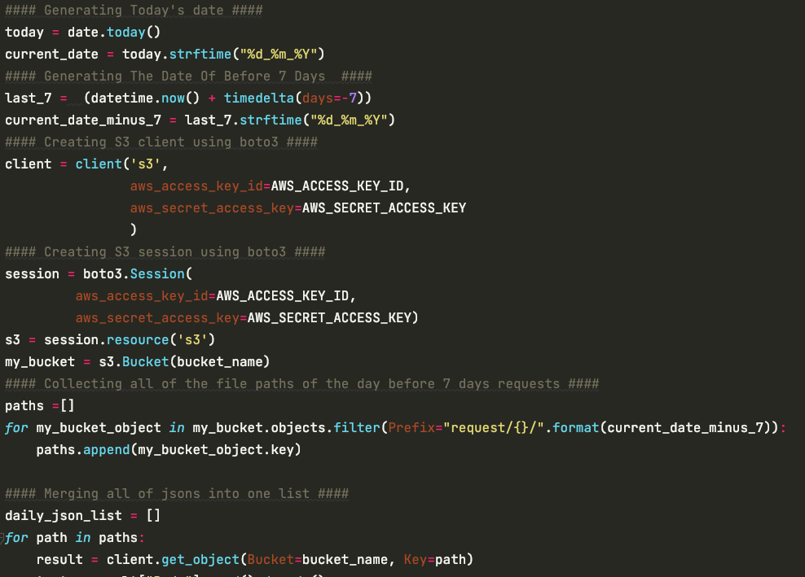
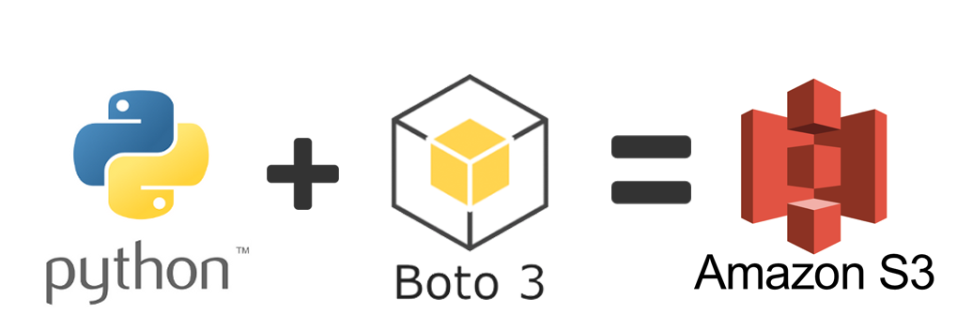
Daily Parquet Archive
Using Boto3 and awswrengler
Taking files older than 7 days

Slide 25
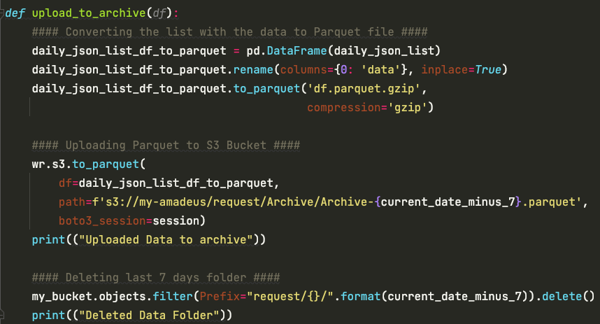
Daily Parquet Archive
Parquet files Saves on cloud storage space with compression
Increased data throughput and performance for analytics use

Slide 26
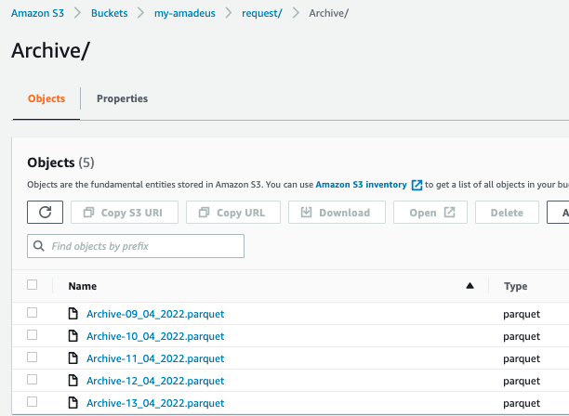
Daily Parquet Archive

Slide 27
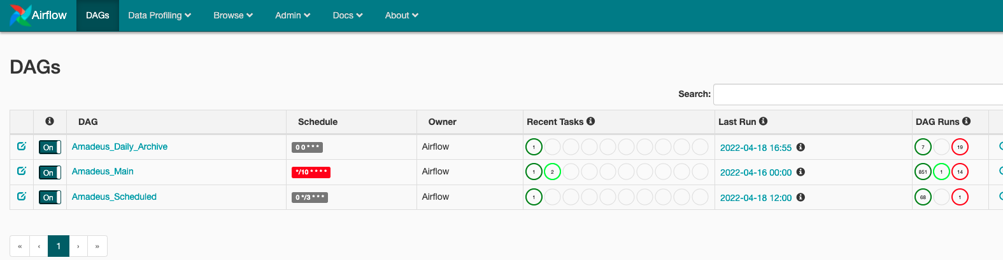
Airflow Dags

Slide 28
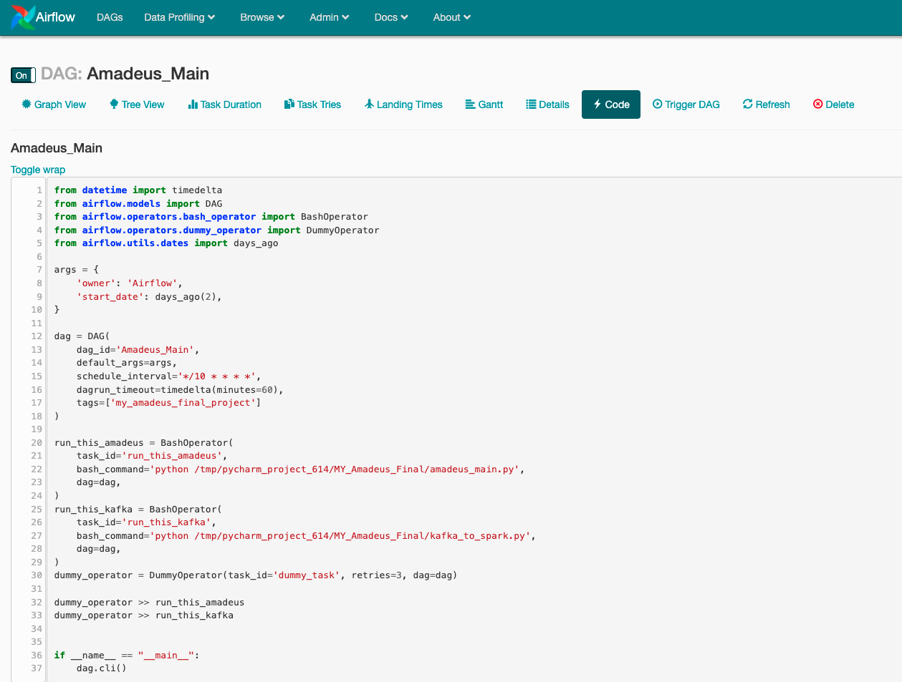
Airflow Dags
Using bashOperator
Parallel tasks run

Slide 29
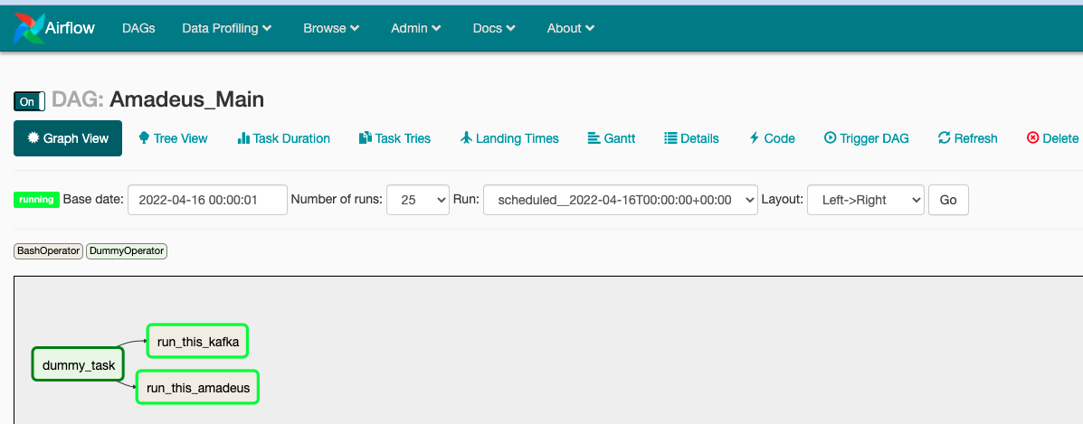
Airflow Dags
Change of Architecture from Sequential to Local to support parallel tasks run and replace DB from SQLite to Mysql

Slide 30

Q&A
Thank You!

